Slide 1
Document Classification

Slide 2
Document Classification by Contents
Classification: the most widespread practical application of machine intelligence
  Perhaps the most useful: spam filtering
  eMail, SMS, news, even community contents/comments

Slide 3
Filtering Spam
Early attempts for filtering: rules
  Overuse of capital letters
  Words related to pharmaceutical products
  Particularly garish HTML colors.
Problems of rule-based approaches
  Spammers learned all the rules and stopped exhibiting the obvious behaviors
  What if people never learned to turn off the Caps Lock key?
Solution: learn from examples

Slide 4
Documents and Words
To classify items, we need features
Feature: anything that can determined as being either present or absent in the item
Document classification: what are the features?
Unit of features
  Words!
  Word pairs, phrases
  Characters?
What about this:

Slide 5
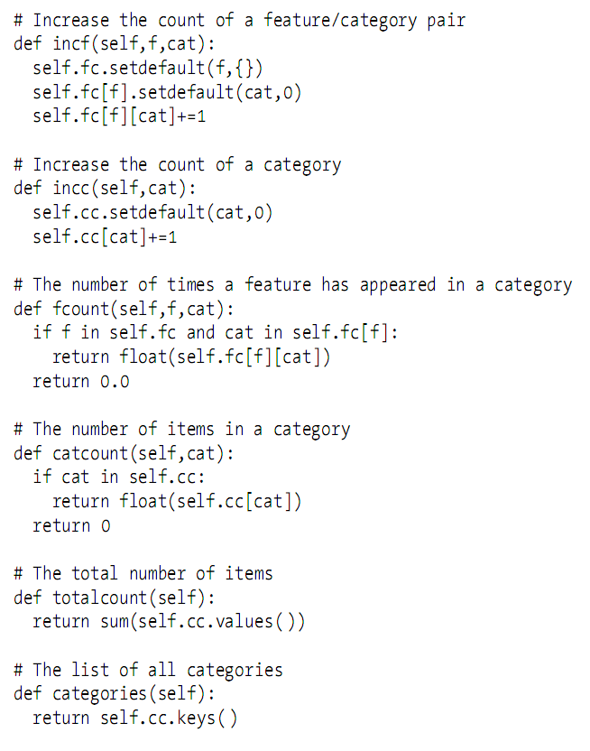
Helper Methods

Slide 6
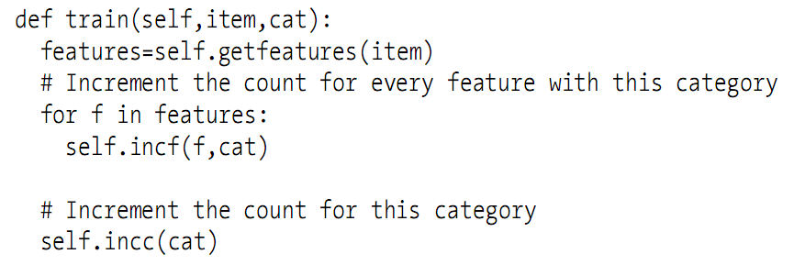
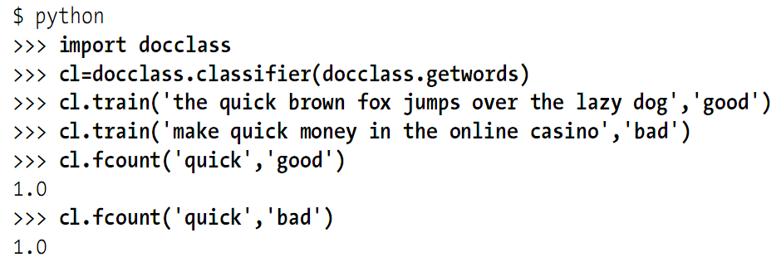
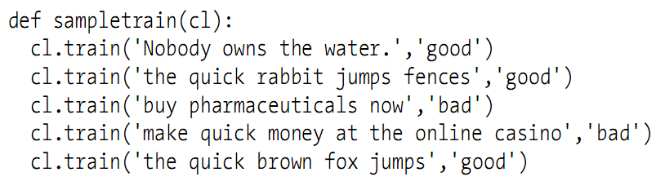
Training a Classifier
Just do the statistics!

Slide 7

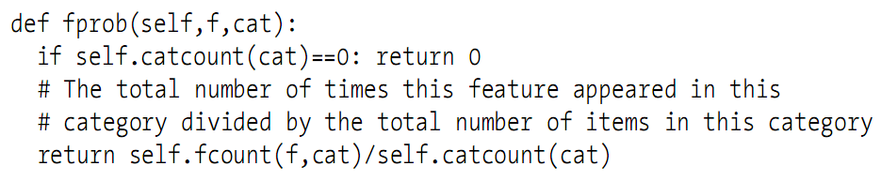
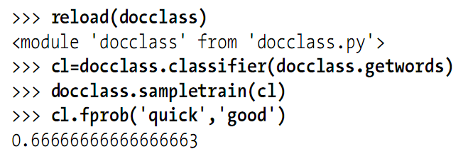
Calculating Probabilities
Feature probabilities(conditional probability):

Slide 8
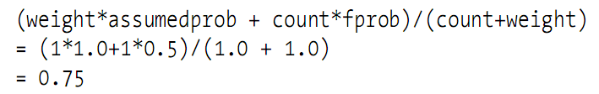
Problem of Feature Probabilities
Using only the information it has seen so far
  Incredibly sensitive during early training!
  Incredibly sensitive to rare words!
    Think what if a word appears only once
Solution: assumed probability
  How about starting from a reasonable guess, like 0.5?
  For example:

Slide 9
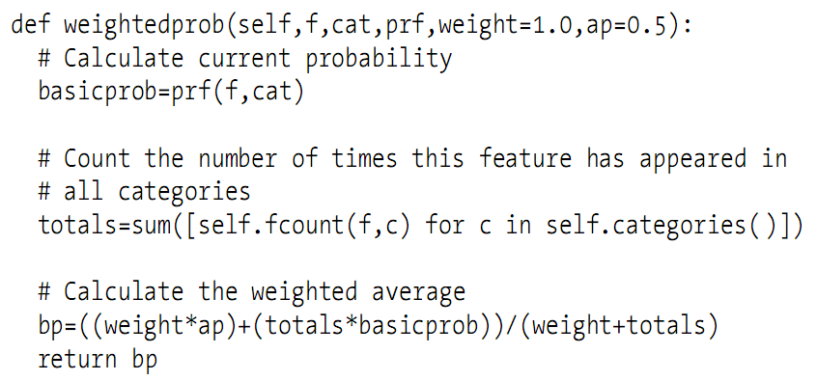
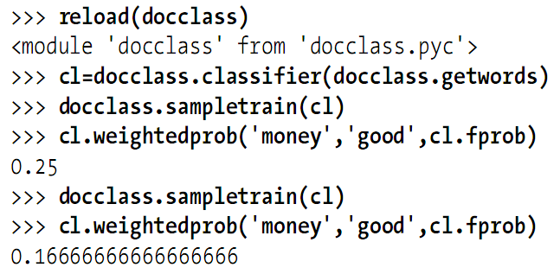
Weighted with Assumed Probability

Slide 10
Naïve Bayesian Classifier
Naïve: probabilities being combined are independent of each other
This is actually a false assumption
  But surprisingly effective!

Slide 11
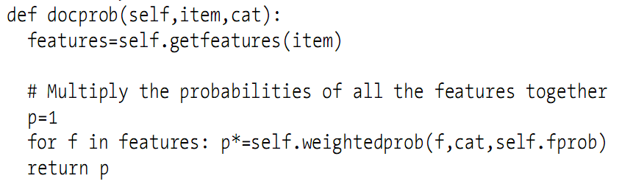


Document Probability
Now you know how to calculate:
For classification, what we need is
So what should we do?

Slide 12
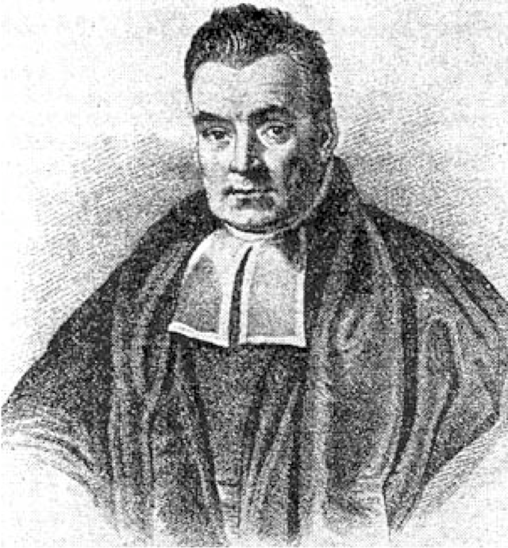
Thomas Bayes
Thomas Bayes
  1701 – 1761/04/07
  British mathematician

Slide 13
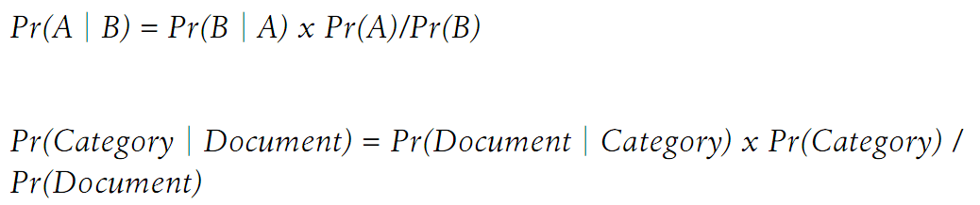
Bayes’ Theorem
Bayes’s theorem
You can calculate every part of the equation!
  Is Pr(Document) necessary?

Slide 14
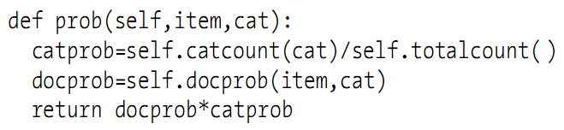
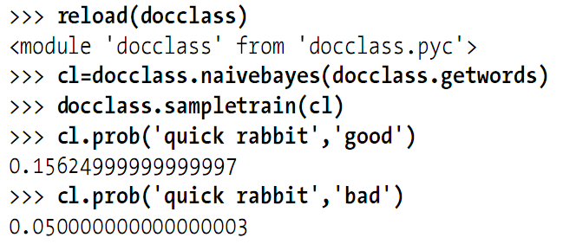
Bayesian Guess
from: http://en.wikipedia.org/wiki/Correlation

Slide 15
Final Step: Choosing a Category
For this item, calculate probability for each category
Consider spam filtering
  Avoid false classification is important: you want to search the spam folder for your important mail?
Minimum threshold of category
  Example: for spam filtering, the threshold to be filtered to bad could be 3, so that the probability for bad would have to be 3 times higher than the probability for good

Slide 16
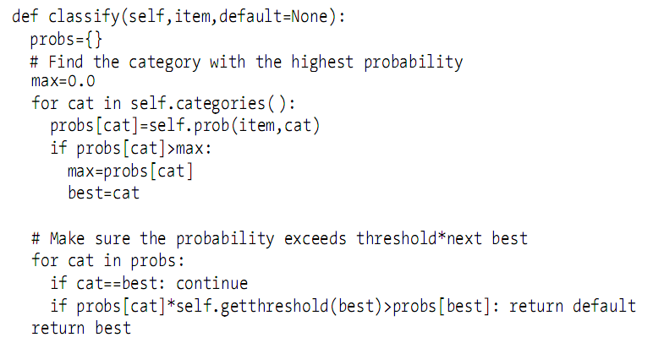
Minimum Threshold Consideration

Slide 17
The Fisher Method
Alternative method with very accurate results
  Particularly for spam filtering
Bayesian filter combines feature probabilities to create document probability
Fisher method calculates the probability of a category for each feature
  Allows much greater flexibility when choosing cutoffs for categorization
Note not all reviewers have seen all movies!

Slide 18

Category Probability
Calculate this:
Which is normally this:
  May cause bias, why?
  How to solve? Normalization

Slide 19
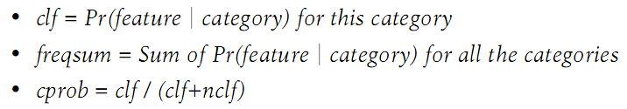
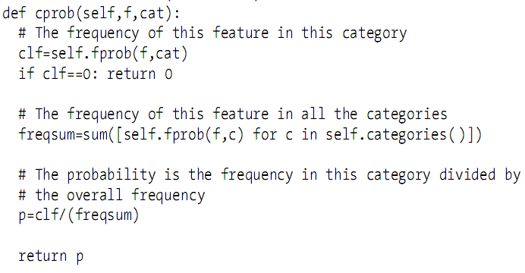
Category Probability Normalization
clf+nclf = freqsum

Slide 20
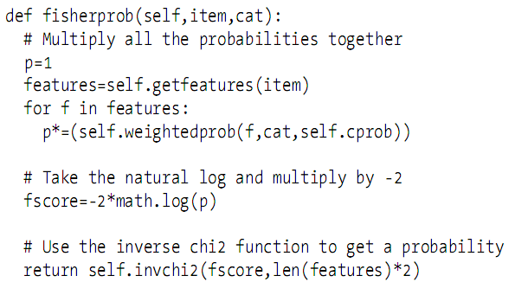
Combining Probabilities

Slide 21
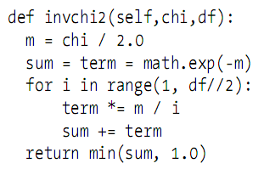
The Use of Chi-square
Fisher showed that if the probabilities were independent and random, the result of this calculation would fit a chi-squared distribution
  Feeding the result of the Fisher calculation to the inverse chi-square function
  Result always between 0 and 1

Slide 22
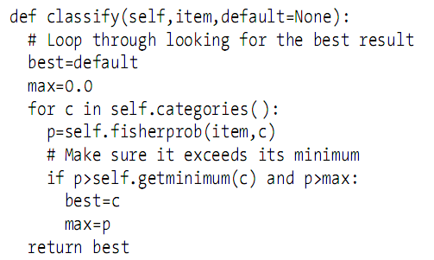
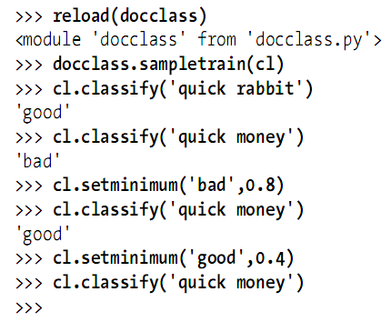
Classifying Items

Slide 23
Summary
Bayesian filter has good result in average case
The Fisher classifier is believed to perform better for spam filtering in practice

